Slide 2
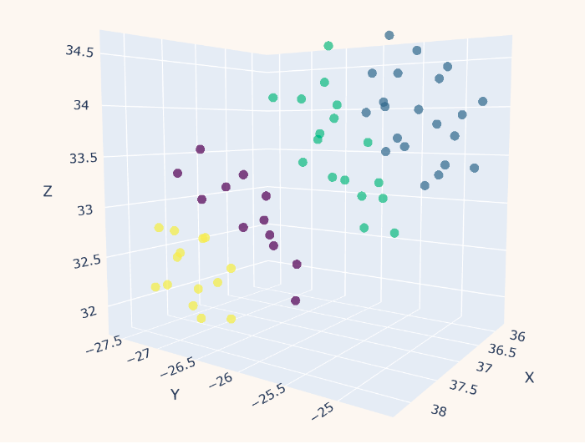
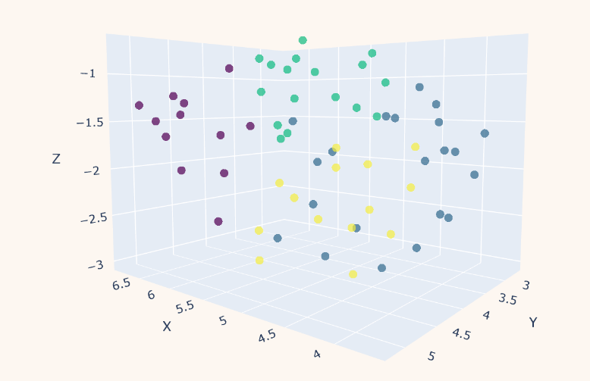
Diff btw order of Kmeans and Dimensional reduction
Diff btw order of Kmeans and Dimensional reduction
Diff btw order of Kmeans and Dimensional reduction

Slide 3
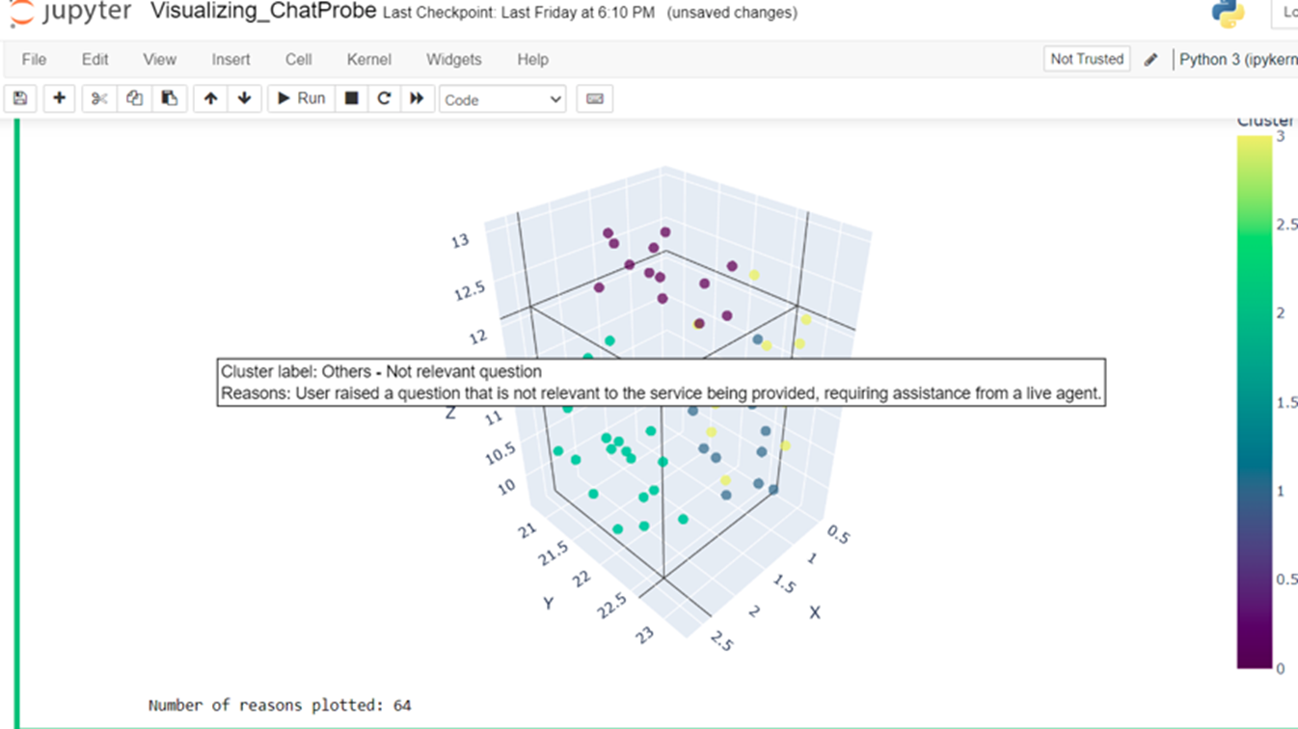
Label: Intent+SubIntent

Slide 4
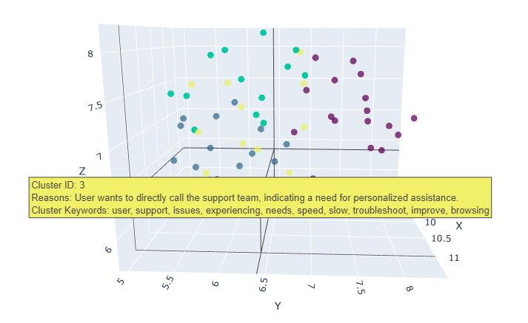
Label:Ids + Keywords

Slide 5
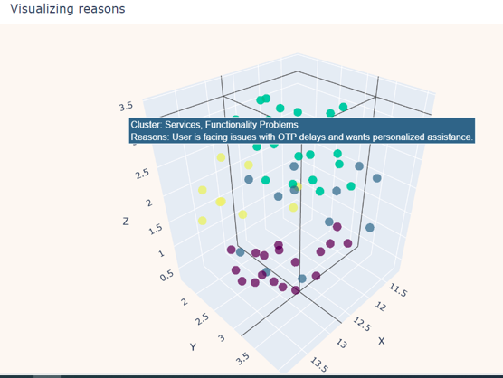
Label:Static

